Slide 1

Presentation on Product Information management
By
Ahsan Ahmed
Date: 22/12/2023

Slide 2
Agenda
Introduction
Problem statement
Model/Schema overview
ER Diagram
Unit Test cases
Live Demo

Slide 3
INtroduction
Product Information Management (PIM) is the cornerstone of efficient and effective data handling in modern businesses. It revolves around the centralized organization, enrichment, and dissemination of product data across various channels. PIM ensures that accurate, consistent, and up-to-date information about products is readily available, enabling companies to enhance customer experiences, streamline marketing efforts, and accelerate time-to-market for new offerings. In an increasingly competitive market, mastering PIM is pivotal for businesses aiming to deliver quality products while maintaining a competitive edge.

Slide 4
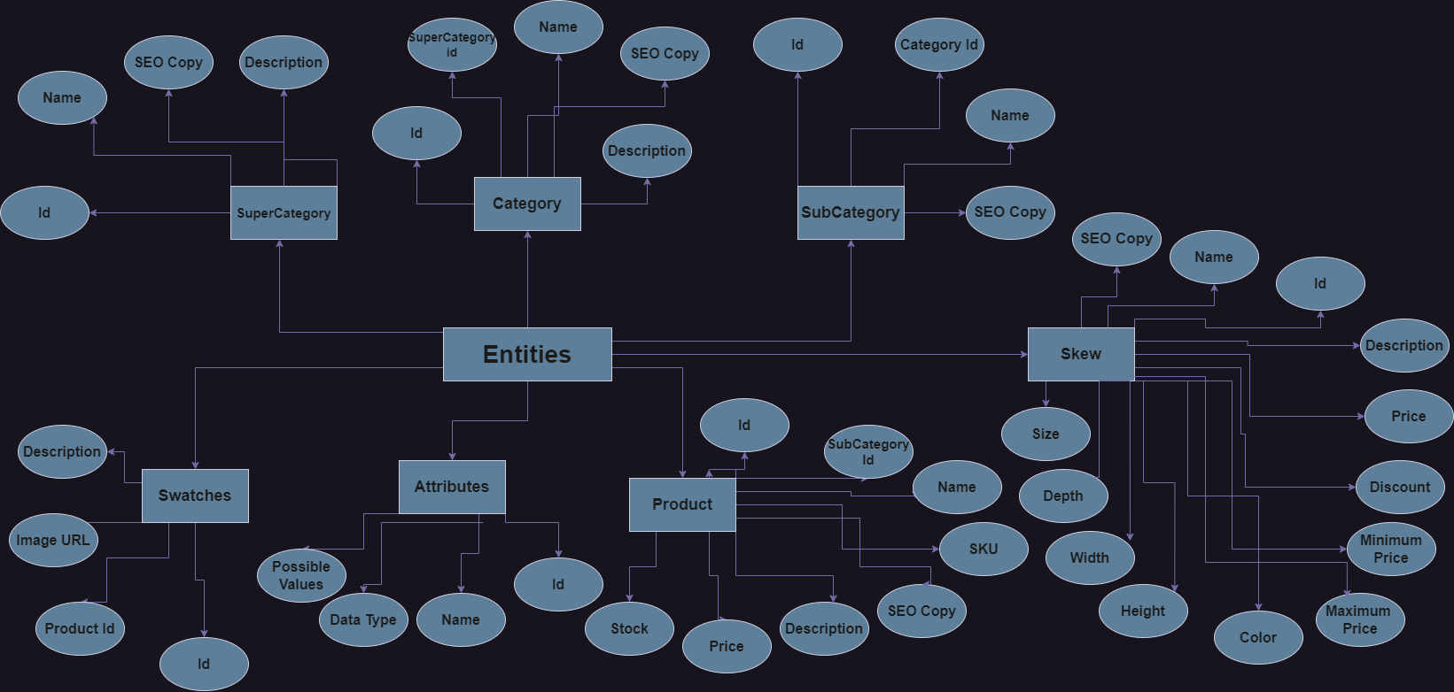
ER Diagram

Slide 5
Unit test Cases
Serial no | Test Cases | Test Data | Result
1 | Get All the data present in super category | Get | Getting all the data of super category present in database
2 | Update the data we want using id in SuperCategory | Put | Getting the data updated in the database for super Category

Slide 6
Live Demo

Slide 7


